Slide 1
Assignment#1 Start-up Codes
Optimal, Informed, Incremental Robot Path-Planning
n.h.reyes@massey.ac.nz

Slide 2
Algorithms
A* with Strict Expanded List
IDA*
Pick one
LPA*
D*Lite
2 Algorithms to implement and test
D*Lite and _______________.
means required

Slide 3
Algorithms
LPA*
First search:
Compute the shortest path, on the assumption that all unknown cells to be blocked (type 9), are traversable. Note that type 8 cells are unknown to be traversable, and so they are assumed to be blocked.
Show the shortest path.
Second search:
Let all unknown cells be known to the robot: Type 9 cells are actually blocked. Type 8 cells are actually traversable. (Here, we assume that the world has changed and the robot finds out all the new details).
Perform replanning.
Show the shortest path.

Slide 4
makefile
Main.exe : Main.o transform.o AstarSearch.o LPAstar.o dstar.o gridworld.o graphics.o
g++ -o Main.exe Main.o transform.o AstarSearch.o LPAstar.o dstar.o gridworld.o graphics.o -l gdi32
Main.o : Main.cpp graphics.h transform.h AstarSearch.h LPAstar.h dstar.h gridworld.h globalvariables.h
g++ -c -std=c++11 -O2 Main.cpp
transform.o : transform.cpp transform.h
g++ -c -std=c++11 -O2 transform.cpp
AstarSearch.o : AstarSearch.cpp AstarSearch.h
g++ -c -std=c++11 -O2 AstarSearch.cpp
LPAstar.o : LPAstar.cpp LPAstar.h
g++ -c -std=c++11 -O2 LPAstar.cpp
gridworld.o : gridworld.cpp gridworld.h
g++ -c -std=c++11 -O2 gridworld.cpp
graphics.o : graphics.cpp graphics.h
g++ -c -std=c++11 -O2 graphics.cpp
clean:
del *.o
del *.exe
Must be preceded by a tab.
Download sublime text and the latest gcc
Instructions are provided via Stream
Notes:
The -Wl,xxx option for gcc passes a comma-separated list of tokens as a space-separated list of arguments to the linker

Slide 5
Composition of a gridworld
Example #1
TYPE:
'0' - traversable,
'1' - blocked,
'8' – unknown cell (actually traversable),
'9' - unknown cell (actually blocked),
'6' - start vertex,
'7' - goal vertex
Start vertex
0
1
2
3
4
5
0
1 | 1 | 1 | 1 | 1 | 1
1 | 6 | 0 | 0 | 0 | 1
1 | 0 | 0 | 0 | 0 | 1
1 | 8 | 1 | 0 | 0 | 1
1 | 0 | 1 | 9 | 0 | 1
1 | 0 | 0 | 0 | 7 | 1
1 | 1 | 1 | 1 | 1 | 1
1
2
3
Goal vertex
4
5
6

Slide 6
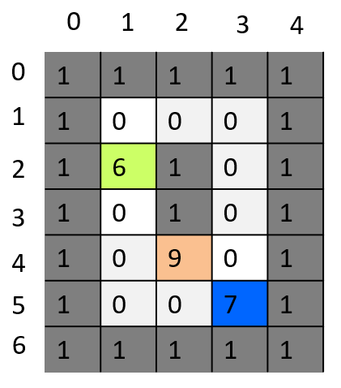
Running the start-up codes
On the command-line:
main <gridworld> {manhattan, euclidean}
C:\Assignment> main grid_Dstar_journal.txt m
Heuristics = MANHATTAN
Device Coordinates(135, 122, 1222, 662)
file opened.
file closed.
Gridworld loaded from file: grid_Dstar_journal.txt
GRIDWORLD_ROWS = 7
GRIDWORLD_COLS = 5
(start.col = 1, start.row = 2)
(goal.col = 3, goal.row = 5)
Start vertex
Goal vertex

Slide 7
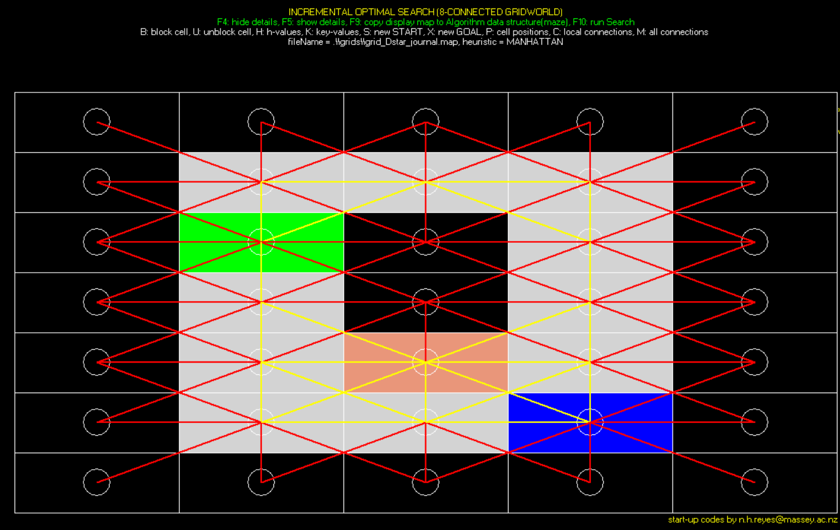
Running the start-up codes
Press ‘M’ to see how the vertices are interconnected.
Blocked cells have all links set to infinity.
Unblocked horizontal and vertical links have values= 1.
Unblocked diagonal links have values= sqrt(2).

Slide 8
Gridworld
How to load and manipulate a gridworld
Gridworld format

Slide 9
Grid in a text file
Create a map and store it in a text file.
Follow the syntax given.
Text file
Gridworld.txt
Number of rows
3
3
111
101
111
Number of of columns
map

Slide 10
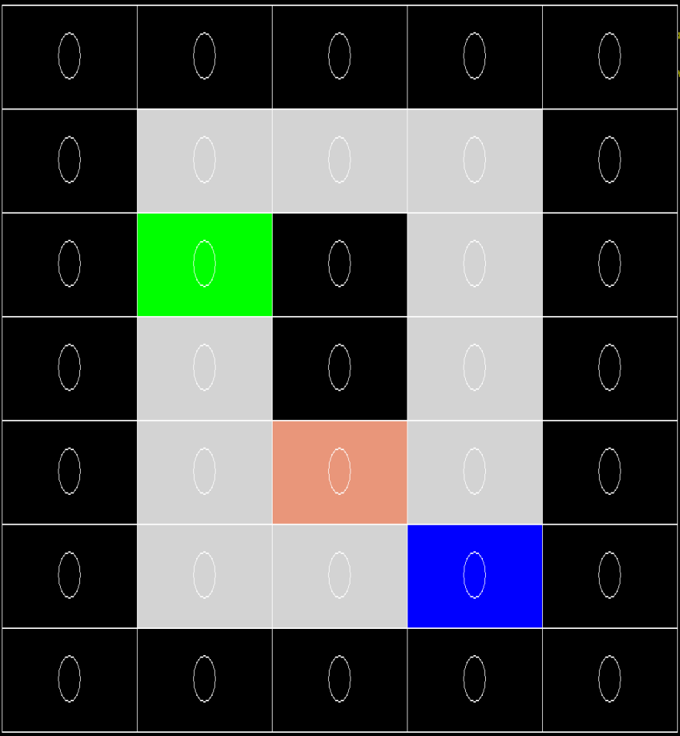
Grid in a text file
Number of rows
Text file
Gridworld.txt
Number of of columns
7
5
11111
10001
16101
10101
10901
10071
11111
map
Note that we are using a margin of obstacles surrounding the entire grid
This will help prevent us from accessing vertices that are out of range.

Slide 11
Grid for display and computations
Instance of class Gridworld
Text file
class GridWorld{
public:
void loadMapAndDisplay(const char* fn);
void displayMap();
…
private:
vector<vector<vertex> > map;
…
};
Gridworld.txt
1
2
3
3
3
111
101
111
1
2
3
A class named GridWorld is provided in the start-up codes, to allow you to load a map from a text file and manipulate the corresponding gridworld (point and click with mouse, keyboard access, etc.)
B-block cell, U-make cell traversable, F5-display vertex details, F4-hide vertex details,
M-show all connections, C-show individual cell connections, S-set start node, X-set goal node, ESC-quit program

Slide 12
Grid for display and computations
Instance of class Gridworld
Text file
class GridWorld{
public:
void loadMapAndDisplay(const char* fn);
void displayMap();
…
private:
vector<vector<vertex> > map;
…
};
Gridworld.txt
1
2
3
3
3
111
101
111
1
2
3
vector<vector<vertex> > map;
gridworld.loadMapAndDisplay(fileName)
To load a gridworld from a file, you can simply call on the loadMapAndDisplay function.
Let us examine the vertex class next…

Slide 13
Vertex
Gridworld
struct Vertex{
//TYPE: 0 - traversable, 1 - blocked, 9 – unknown (actually blocked),
// 8 – unknown (actually traversable),
// 6 - start vertex, 7 - goal vertex
char type;
int row;
int col;
char status; //UNEXPLORED, EXPANDED, ACCESSED
int x1,y1,x2,y2;
Coordinates centre; //centre x, centre y
double rhs;
double g;
double h;
double f;
double key[2];
vertex* move[DIRECTIONS];
double linkCost[DIRECTIONS];
};
1
2
3
1
2
3
Not all of these variables are used.
It depends on which algorithm you are implementing.
enum vertexStatus {UNEXPLORED=0, EXPANDED=1, ACCESSED=2};

Slide 14
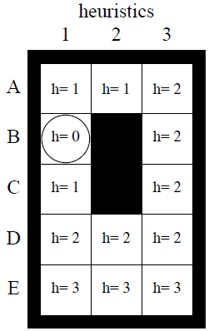
Move Generation
Start/robot
Movement Sequence
 | -1 | 0 | 1
-1 | 1 | 2 | 3
0 | 4 | Current position | 5
1 | 6 | 7 | 8

Slide 15
Move Generation
Start/robot
goal
Movement Sequence
Offset values
+x
 | -1 | 0 | 1
-1 | (-1,-1) | (0,-1) | (1, -1)
0 | (-1, 0) | Current position | (1, 0)
1 | (-1, 1) | (0, 1) | (1, 1)
 | -1 | 0 | 1
-1 | 1 | 2 | 3
0 | 4 | Current position | 5
1 | 6 | 7 | 8
+y
Sequence: (-1,-1), (0, -1), (1, -1)
(-1, 0), (1, 0),
(-1,1), (0,1), (1, 1)
//basic idea:
neighbour_y = current_y + dy[d];
neighbour_x = current_x + dx[d];

Slide 16
Algorithm
How to connect to gridworld?
Where to call inside main()?

Slide 17
Path-planning Algorithm
Instance of class Gridworld
Instance of class LPAStar
Text file
Gridworld.txt
map
maze
1
2
3
3
3
111
101
111
0
1
2
1
0
2
1
3
LPAstar.cpp
2
LPAstar.h
Each of the path-planning algorithms must be implemented in a separate file. (.cpp,.h)
class LPAStar{
public:
friend void copyMazeToDisplayMap(GridWorld &gWorld, LpaStar* lpa);
friend void copyDisplayMapToMaze(GridWorld &gWorld, LpaStar* lpa);
…
private: vector<vector<LpaStarCell> > maze;
};
Depending on the algorithm you are developing, each vertex requires further information (e.g. rhs-value, g-value, h-value, key1, key2, etc.)
For this reason, a specialised maze needs to be constructed based on the gridworld.

Slide 18
Path-planning Algorithm
Instance of class Gridworld
Instance of class LPAStar
Text file
Gridworld.txt
map
maze
1
2
3
3
3
111
101
111
0
1
2
1
0
2
1
3
2
gridworld.loadMapAndDisplay()
Class LPAStar{
public:
friend void copyMazeToDisplayMap(GridWorld &gWorld, LpaStar* lpa);
friend void copyDisplayMapToMaze(GridWorld &gWorld, LpaStar* lpa);
…
private: vector<vector<LpaStarCell> > maze;
};
First, load the gridworld from file.

Slide 19
Path-planning Algorithm
Instance of class Gridworld
Instance of class LPAStar
Text file
Gridworld.txt
map
maze
1
2
3
3
3
111
101
111
0
1
2
1
0
2
1
3
2
gridworld.loadMapAndDisplay()
Class LPAStar{
public:
friend void copyMazeToDisplayMap(GridWorld &gWorld, LpaStar* lpa);
friend void copyDisplayMapToMaze(GridWorld &gWorld, LpaStar* lpa);
…
private: vector<vector<LpaStarCell> > maze;
};
copyDisplayMapToMaze(grid_world, lpa_star);
Once the content of the gridworld has been loaded, you can call on copyDisplayMapToMaze() to create an internal copy of the gridworld inside the path-planning algorithm.

Slide 20
LpaStarCell
Gridworld
struct LpaStarCell {
//TYPE: 0 - traversable, 1 - blocked, 9 – unknown (actually blocked),
// 8 – unknown (actually traversable),
// 6 - start vertex, 7 - goal vertex
char type;
LpaStarCell* move[DIRECTIONS];
double linkCost[DIRECTIONS];
int x, y;
double g;
double rhs;
double h;
double key[2];
};
0
1
2
0
1
2
Feel free to add more data members as required

Slide 21
Path-planning Algorithm
Instance of class Gridworld
Instance of class DStar
Text file
Gridworld.txt
maze
1
2
3
3
3
111
101
111
0
1
2
1
0
2
1
3
2
For graphics display
For path-planning computations
gridworld.loadMapAndDisplay()
copyDisplayMapToMaze(grid_world, lpa_star);
Note:
gridworld.displayPath() was actually designed to work with D*Lite. You need to customise it to work with LPA*.
PATH_FOUND = lpa_star->computeShortestPath();
If(PATH_FOUND) { copyMazeToDisplayMap(grid_world, lpa_star);
gridworld.displayPath(); }
Notes:
Once the shortest path is found, copy the all the results back to the gridworld, for display.

Slide 22
How to display the shortest path?
Pre-requisites:
the shortest path has been found
the function copyMazeToDisplayMap() has been called to update the contents of gridworld.

Slide 23
gridworld.displayPath()
Note that this function is only suited to D*Lite
vertex* currentVertex;
vertex* min_neighbour;
currentVertex = start_vertex
while(1){
find neighbour with min (g+c), set as min_neighbour
totalPath = totalPath + min_linkCost;
draw a line between the current waypoint (currentVertex) to the min_neighbour
currentVertex = min_neighbour;
if currentVertex is already the goal, then we are done.
}

Slide 24
gridworld.displayPath()
Note that this function is only suited to D*Lite
currentVertex = start_vertex
while(1){
find neighbour with min (g+c), set as min_neighbour
totalPath = totalPath + min_linkCost;
draw a line between the current waypoint (currentVertex) to the min_neighbour
currentVertex = min_neighbour;
if currentVertex is already the goal, then we are done.
}
`
currentVertex = &map[startVertex.row][startVertex.col];

Slide 25
gridworld.displayPath()
Note that this function is only suited to D*Lite
currentVertex = start_vertex
while(1){
find neighbour with min (g+c), set as min_neighbour
totalPath = totalPath + min_linkCost;
draw a line between the current waypoint (currentVertex) to the min_neighbour
currentVertex = min_neighbour;
if currentVertex is already the goal, then we are done.
}
`
min_g_plus_c = INF;
for(int m=0; m < DIRECTIONS; m++){
neighbour = originVertex->move[m];
if(neighbour != NULL && neighbour->type != '1'){
linkCost = originVertex->linkCost[m];
g=(originVertex->move[m])->g;
if(min_g_plus_c > sum(g,linkCost)){
min_g_plus_c = sum(g,linkCost);
min_g=g;
min_linkCost = linkCost;
min_neighbour = neighbour;
}
}
}

Slide 26
gridworld.displayPath()
Note that this function is only suited to D*Lite
currentVertex = start_vertex
while(1){
find neighbour with min (g+c), set as min_neighbour
totalPath = totalPath + min_linkCost;
draw a line between the current waypoint (currentVertex) to the min_neighbour
currentVertex = min_neighbour;
if currentVertex is already the goal, then we are done.
}
`
setcolor(RED);
setlinestyle(SOLID_LINE, 1, 1);
line(min_neighbour->centre.x, min_neighbour->centre.y, currentVertex->centre.x, currentVertex->centre.y);

Slide 27
gridworld.displayPath()
Note that this function is only suited to D*Lite
currentVertex = start_vertex
while(1){
find neighbour with min (g+c), set as min_neighbour
totalPath = totalPath + min_linkCost;
draw a line between the current waypoint (currentVertex) to the min_neighbour
currentVertex = min_neighbour;
if currentVertex is already the goal, then we are done.
}
`
if(currentVertex == &map[goalVertex.row][goalVertex.col]) break;

Slide 28
System of coordinates
For display
For path computations
GRIDWORLD
MAZE
1
2
3
0
1
2
1
0
2
1
3
2
This is because of the margin of obstacles surrounding the gridworld
TYPE: '0' - traversable, '1' - blocked, '8' - unknown (actually traversable),'9' - unknown (actually blocked), '6' - start vertex, '7' - goal vertex

Slide 29
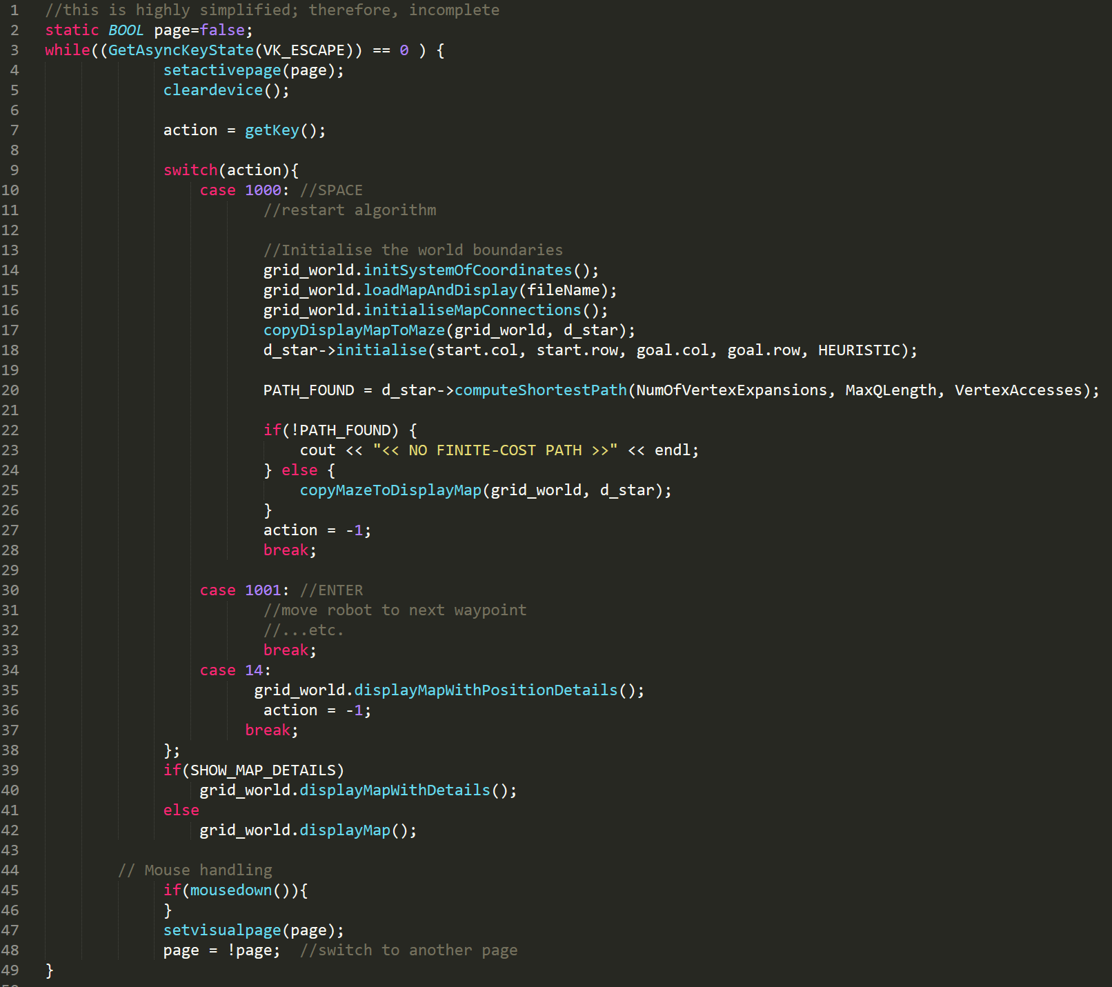
MAIN LOOP

Slide 30
Display resolution
Inside main(), you can change the display resolution of your simulation.
e.g.

Slide 31
Unleash your imagination!
Feel free to add more files, classes, enhancements to the codes, as necessary.
Bonus marks will be given to substantial algorithm enhancements (for fast execution, additional capabilities) made to the codes.

Slide 32
End of Presentation

Slide 33
Composition of a gridworld
Example #2
TYPE:
'0' - traversable,
'1' - blocked,
'8' – unknown cell (actually traversable),
'9' - unknown cell (actually blocked),
'6' - start vertex,
'7' - goal vertex
0
1
2
3
4
0
1 | 1 | 1 | 1 | 1
1 | 0 | 0 | 0 | 1
1 | 6 | 1 | 0 | 1
1 | 0 | 1 | 0 | 1
1 | 0 | 9 | 0 | 1
1 | 0 | 0 | 7 | 1
1 | 1 | 1 | 1 | 1
1
2
3
4
5
6
GRIDWORLD_ROWS = 7
GRIDWORLD_COLS = 5
(start.col = 1, start.row = 2)
(goal.col = 3, goal.row = 5)

